Slide 1

MIT Art Design and Technology University MIT School of Computing, Pune
21BTCS503 –Introduction to Data Science
Class - T.Y. (SEM-V), Core
Unit - III Statistics and Probability basics for Data Analysis
AY 2024-2025 SEM-V

Slide 2
Unit III - Syllabus
Unit III – Statistics & Probability basics for Data Analysis 08 hours
Statistics: Describing a Single Set of Data, Correlation, Simpson’s Paradox, Some Other Correlational Caveats, Correlation and Causation Probability : Dependence and Independence, Conditional Probability, Bayes’s Theorem, Random Variables, Continuous Distributions, The Normal Distribution, The Central Limit Theorem

Slide 3
Single Set of Data
A single set of data refers to a collection of information or observations that are grouped together as a cohesive unit.
It typically consists of multiple instances or data points, each representing a specific record or observation.
In the context of data science, a single set of data can refer to a dataset that contains information related to a specific problem or domain.
This dataset may include various variables or attributes, each representing different aspects or measurements of the data.

Slide 4
Correlation
When two sets of data are strongly linked together we say they have a High Correlation.
The word Correlation is made of Co- (meaning "together"), and Relation
Correlation is Positive when the values increase together, and
Correlation is Negative when one value decreases as the other increases

Slide 5
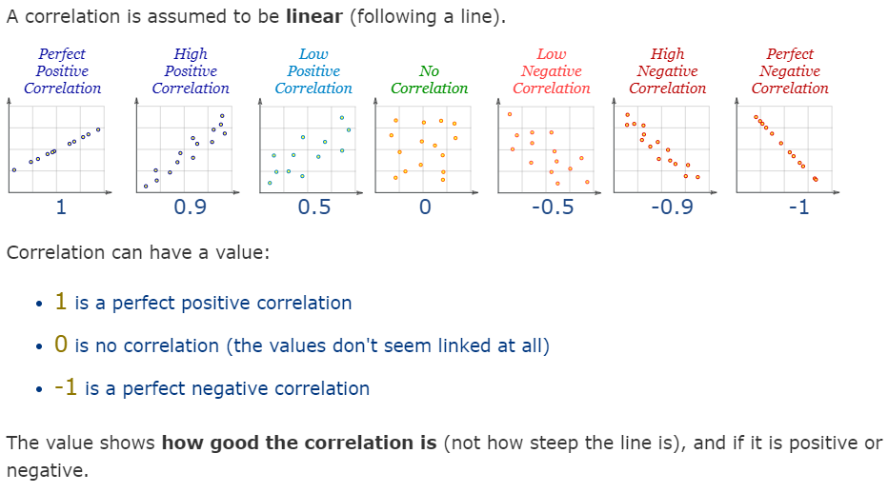

Slide 6
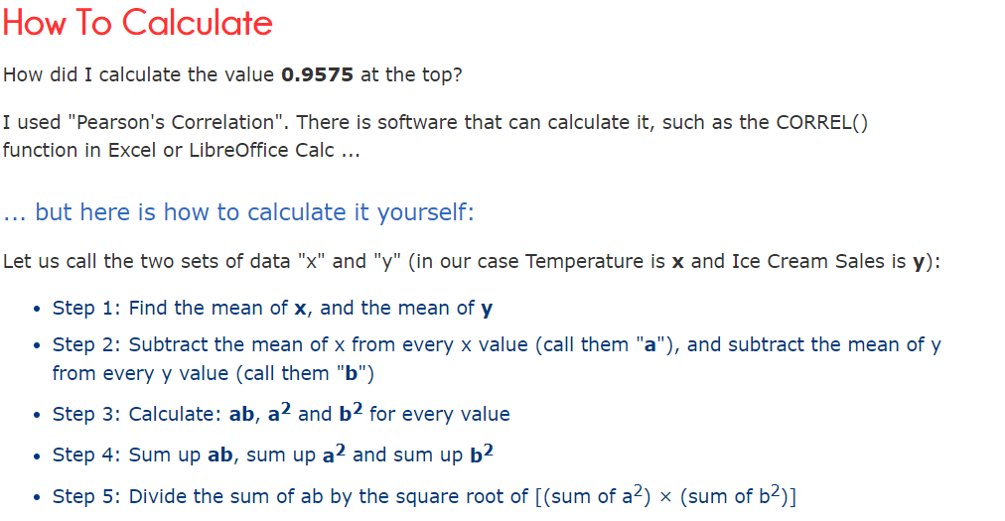

Slide 7
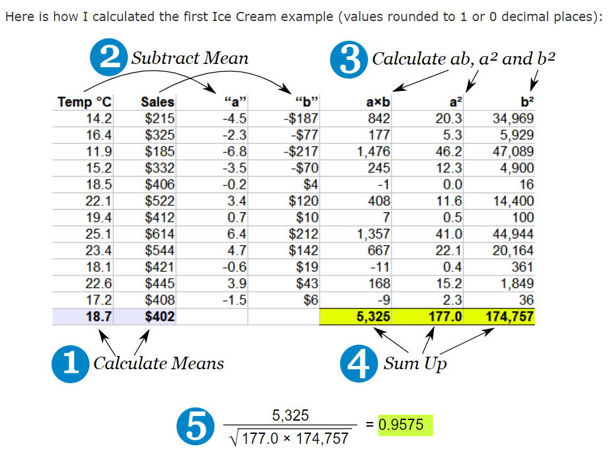

Slide 8
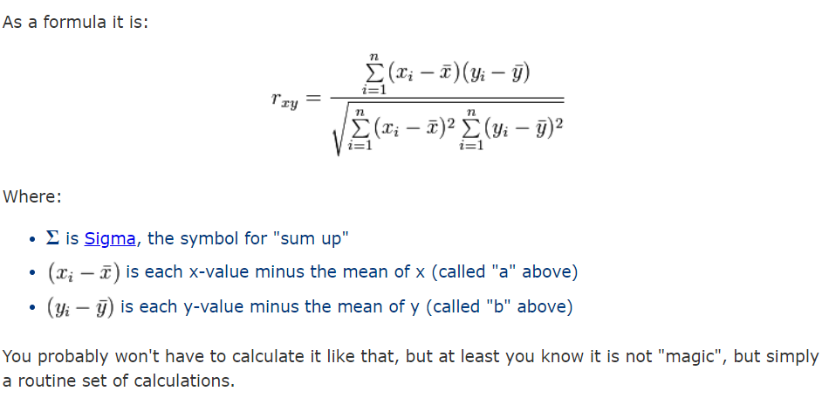

Slide 9
Simpson’s Paradox
Simpson’s Paradox is a classic example of how statistics can be wrong. The paradox is that averages can be silly and misleading. Sometimes they can be just plain baffling.
An example of Simpson’s Paradox:
Votes case in a recent election: 120,045.
Number of voting precincts: 109.
Number of voters who own dogs: 19,876.
Average = (120,045 + 109 + 19,876) / 3 = 46,677.
The “average” above is correct math, but it makes no sense to take an average of voters, precincts, and the number of voters who own dogs. In real life, the paradox is usually more subtle.

Slide 10
What is Causal Relation?
A causal relationship refers to a cause-and-effect connection between two variables, where changes in one variable directly lead to changes in another variable.
In the context of correlation, it is important to note that correlation does not imply causation.
While a correlation indicates that two variables are related or move together in some way, it does not establish a cause-and-effect relationship between them.
Correlation measures the statistical association or relationship between variables, quantifying the degree to which they vary together.
It indicates the strength and direction of the linear relationship between variables but does not provide information about the underlying mechanism or whether one variable directly influences the other.

Slide 11
Key Caveats with Correlations
There are three key caveats that must be recognized with regard to correlation.
It is impossible to prove causal relationships with correlation. However, the strength of the evidence for such a relationship can be evaluated by examining and eliminating important alternate explanations for the correlation seen.
Outliers can substantially inflate or deflate the correlation.
Correlation describes the strength and direction of the linear association between variables. It does not describe non-linear relationships

Slide 12

Covariance is a statistical measure that indicates the extent to which two random variables change together. It provides insight into the direction of the linear relationship between the variables. If the variables tend to increase or decrease together, the covariance is positive; if one tends to increase when the other decreases, the covariance is negative.

Slide 13
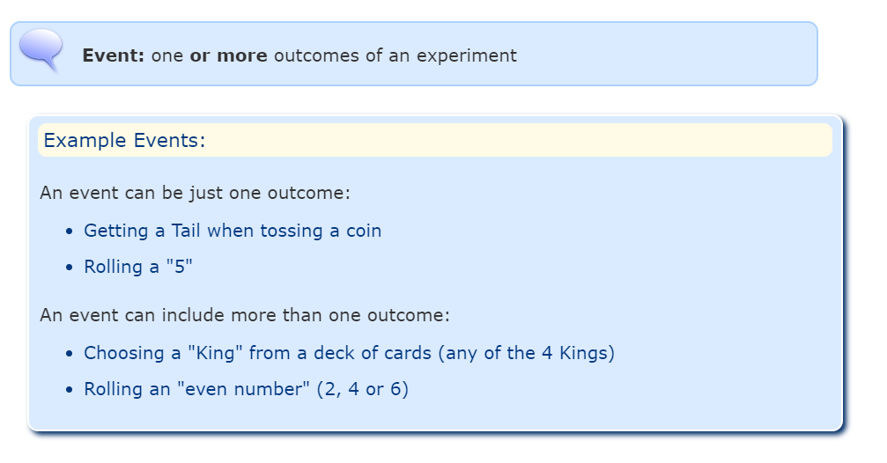
Probability- Events

Slide 14
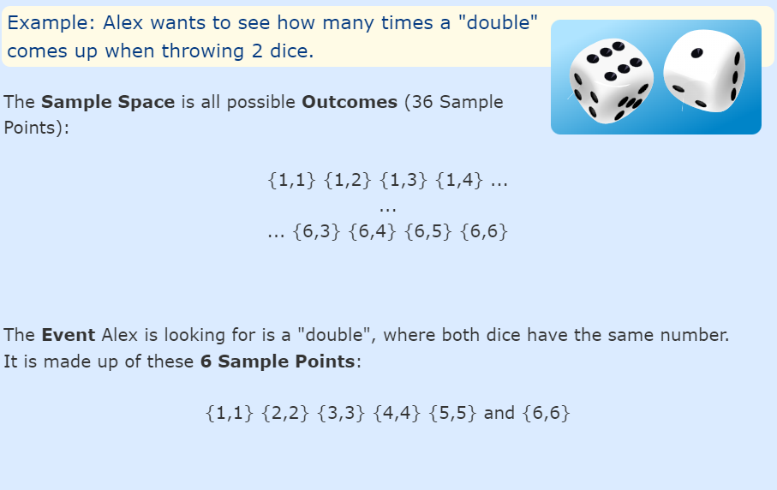

Slide 16
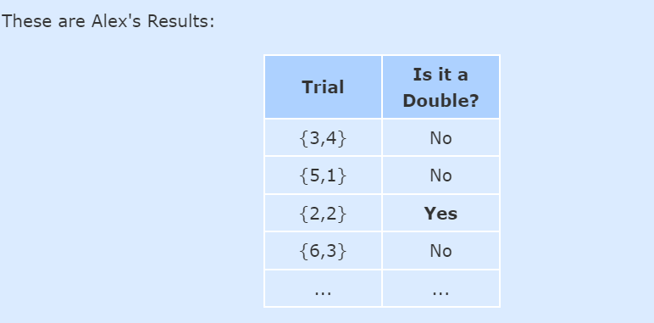

Slide 17
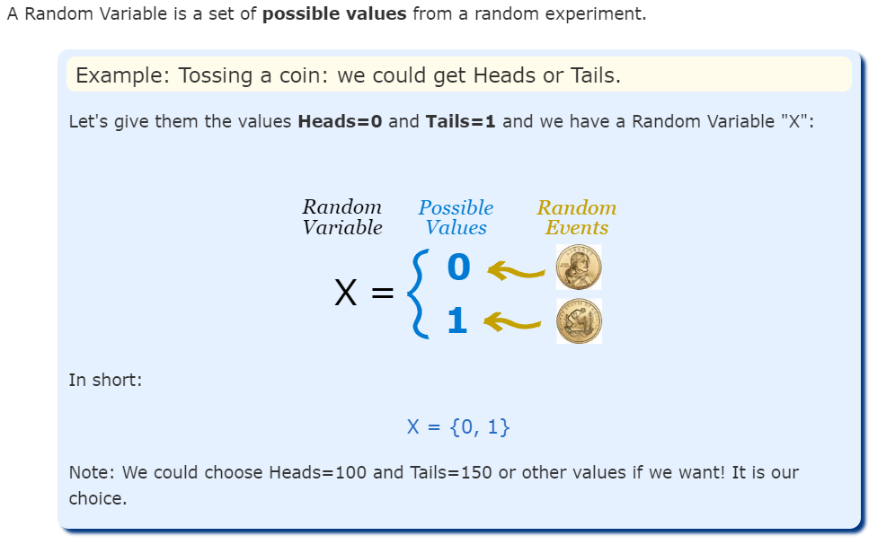
Probability- Random Variables

Slide 18
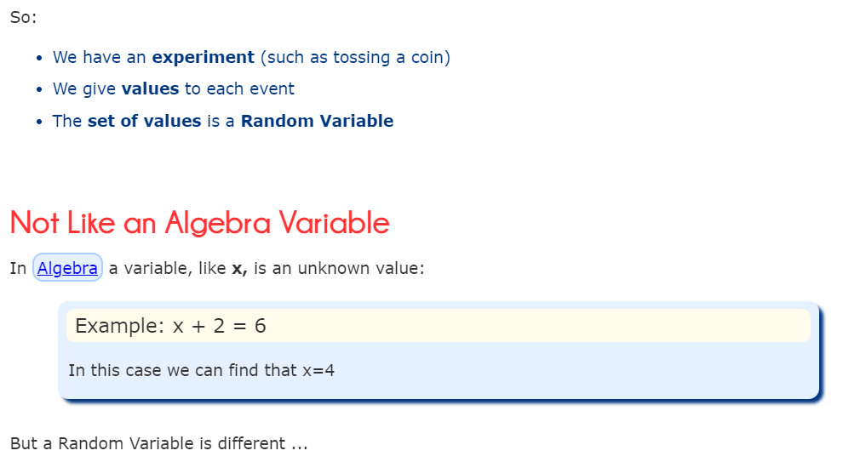

Slide 19
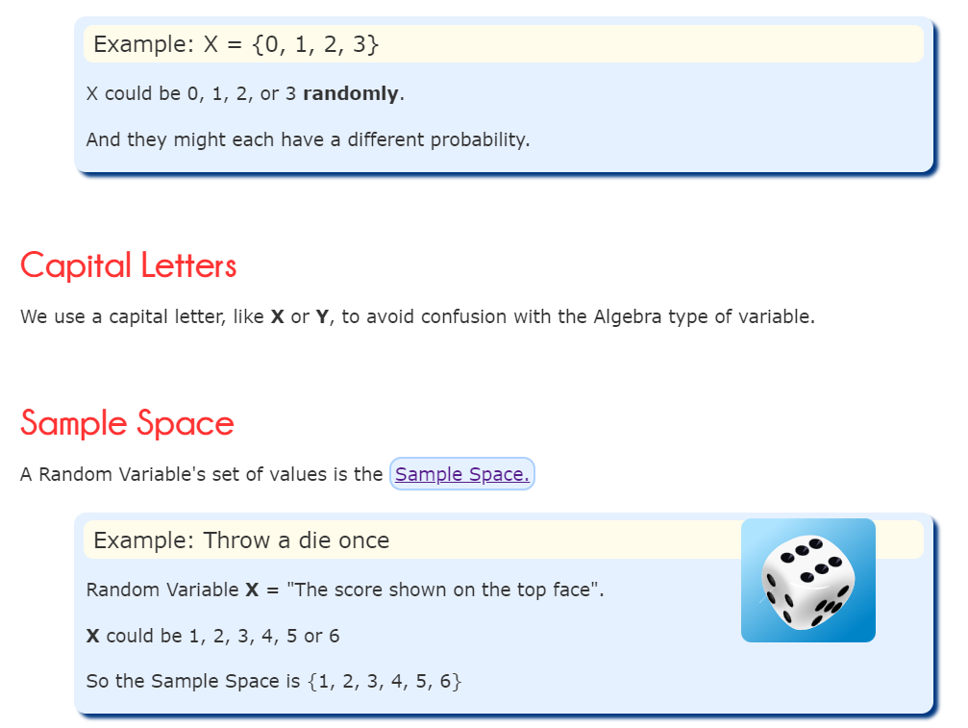

Slide 20
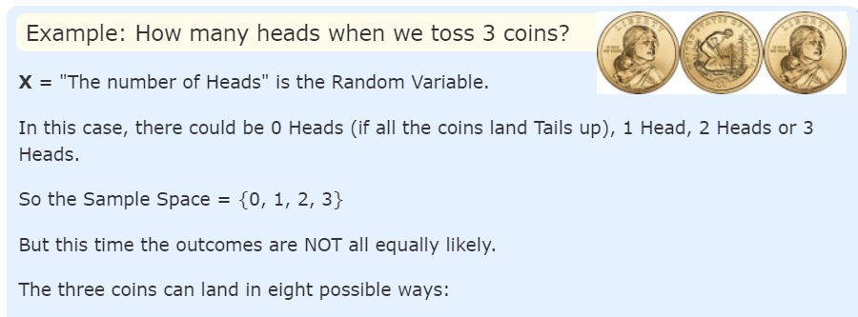

Slide 21
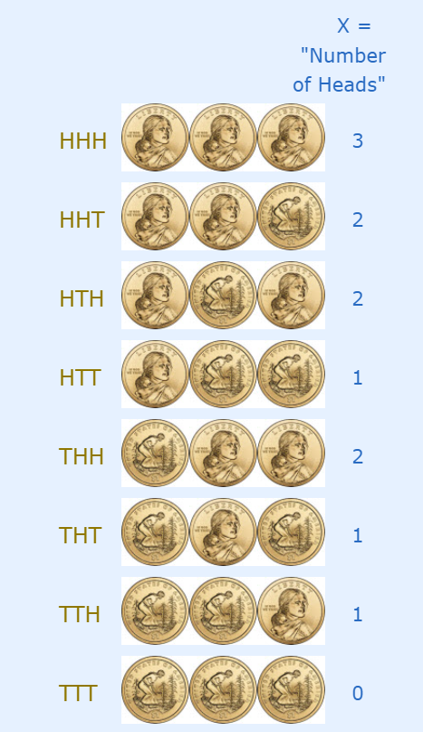
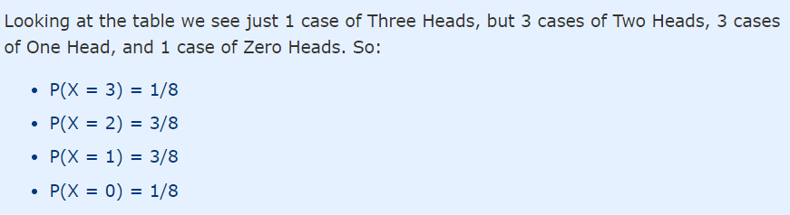

Slide 22
Dependence and Independence
In probability theory, dependence and independence refer to the relationship between events or random variables.
Dependence: The outcome of one event or variable affects the probability distribution or behavior of the other.
There are different types and degrees of dependence, such as
positive dependence (when one event increases the likelihood of the other) or
negative dependence (when one event decreases the likelihood of the other).
Independence: In this case, the outcomes of the events or variables are not related, and knowledge of one event or variable does not affect the probability distribution or behavior of the other.

Slide 23
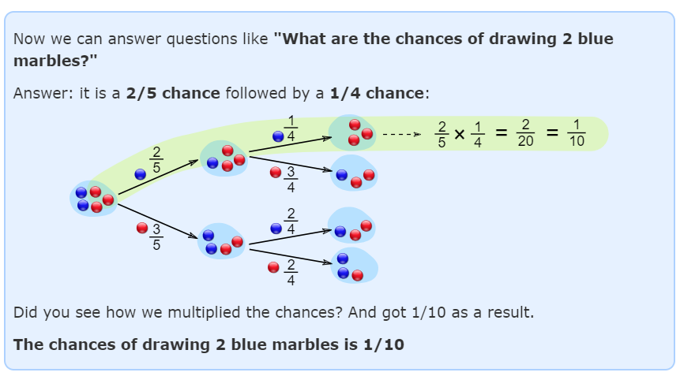
Conditional Probability

Slide 24
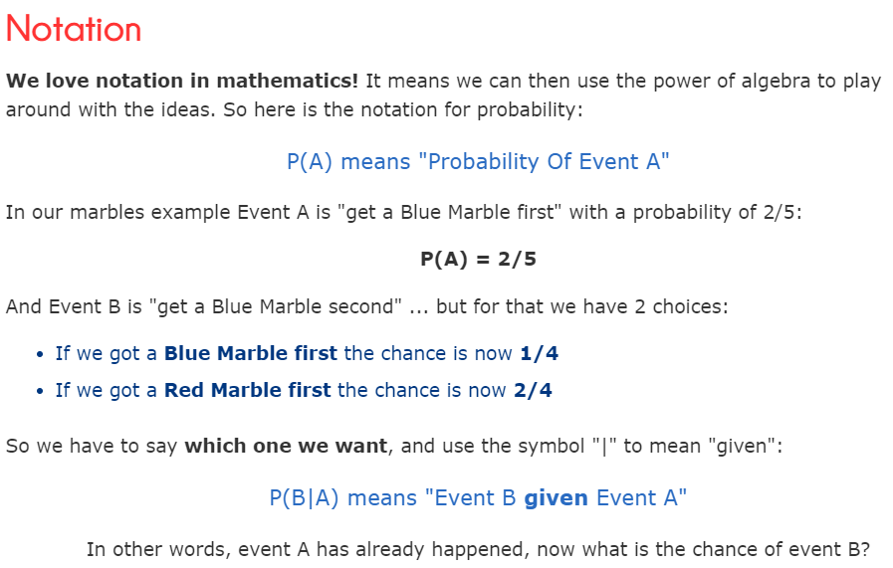

Slide 25
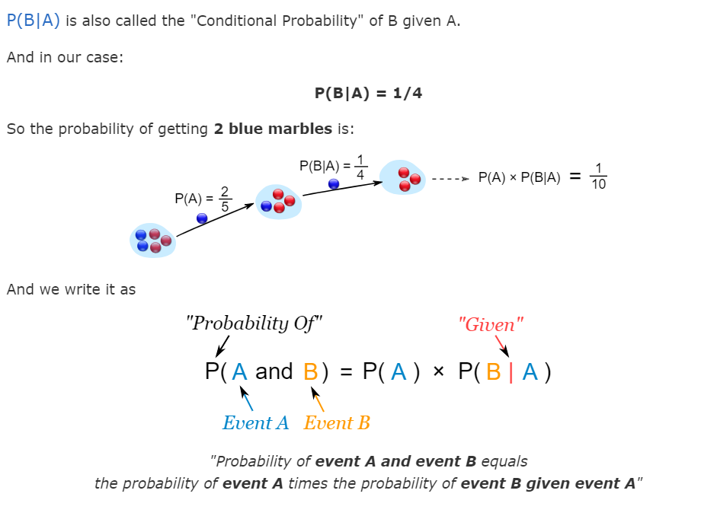

Slide 26
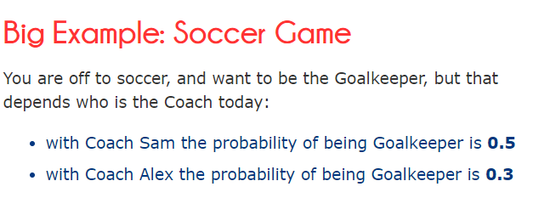
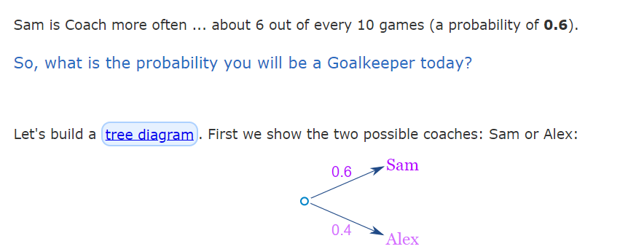

Slide 27
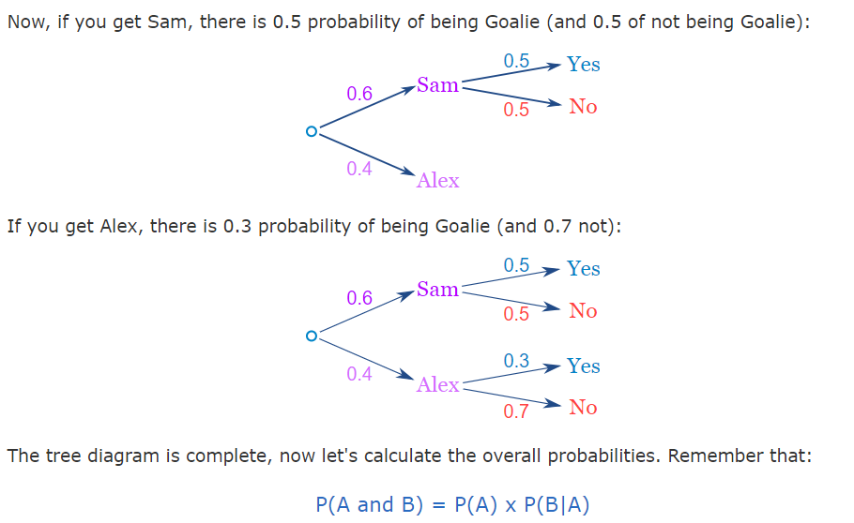

Slide 28
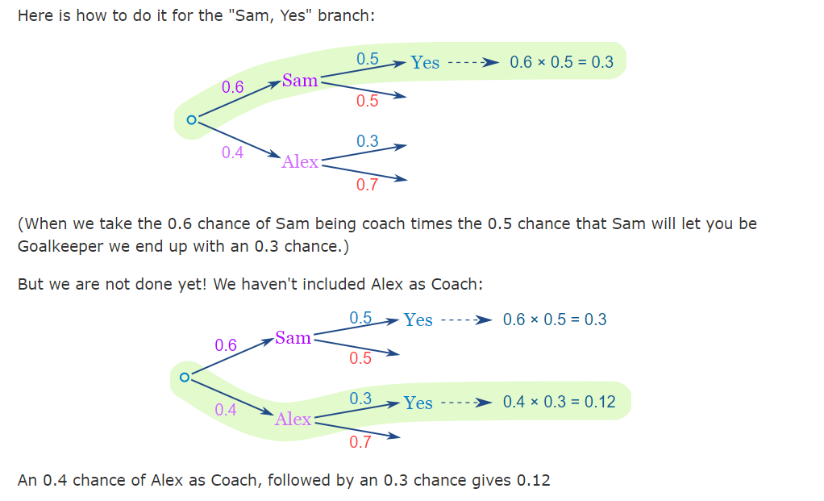

Slide 29
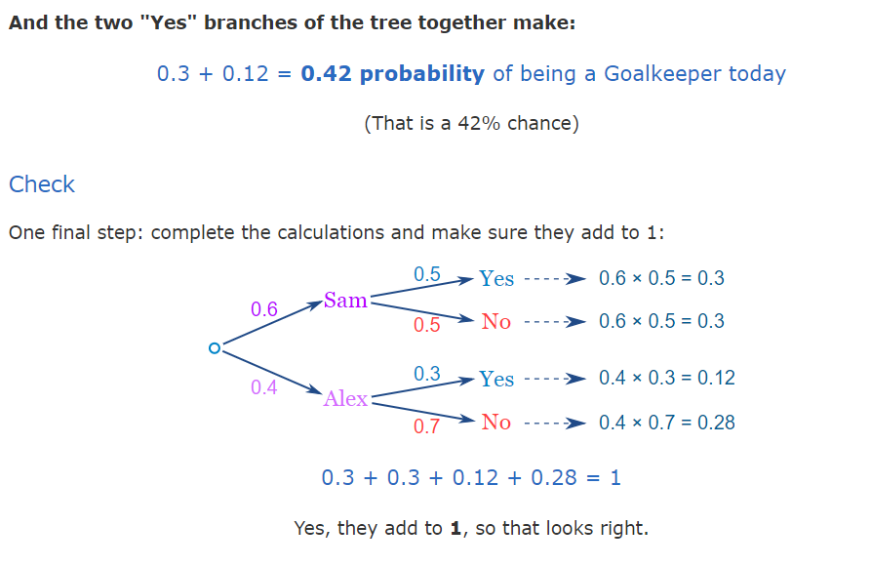

Slide 30
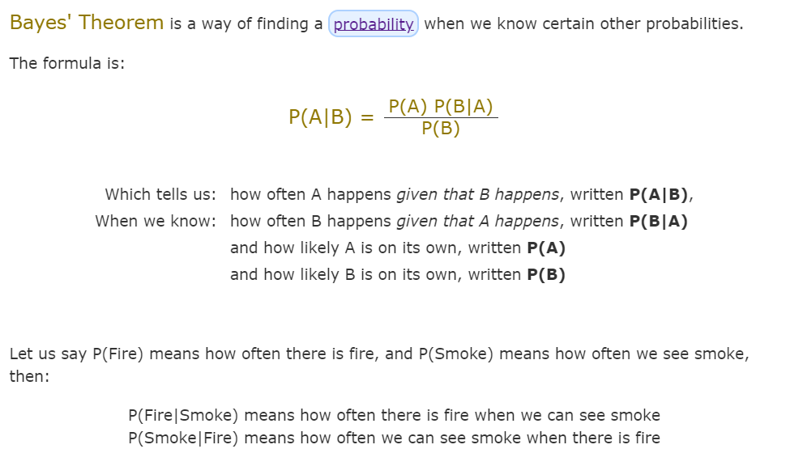

Slide 31
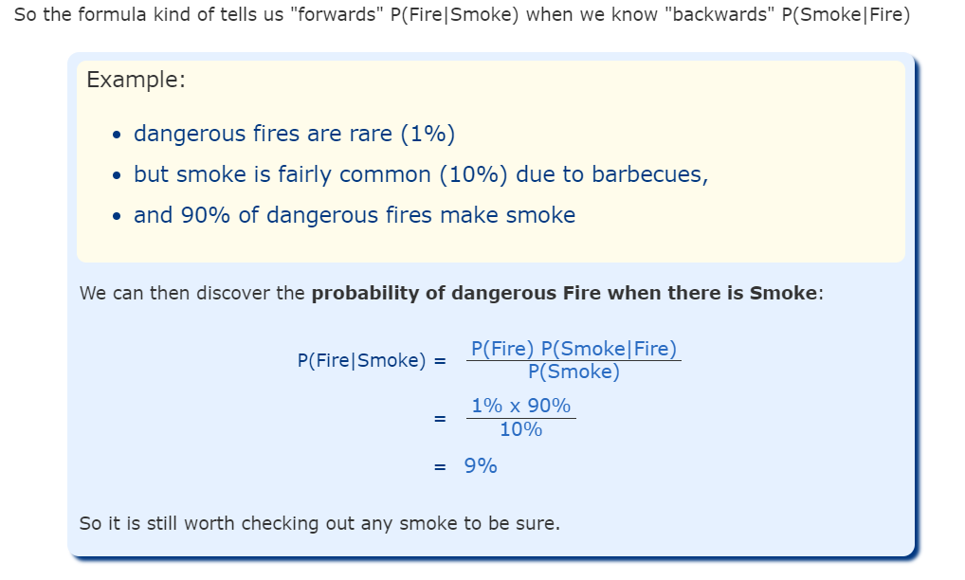

Slide 32
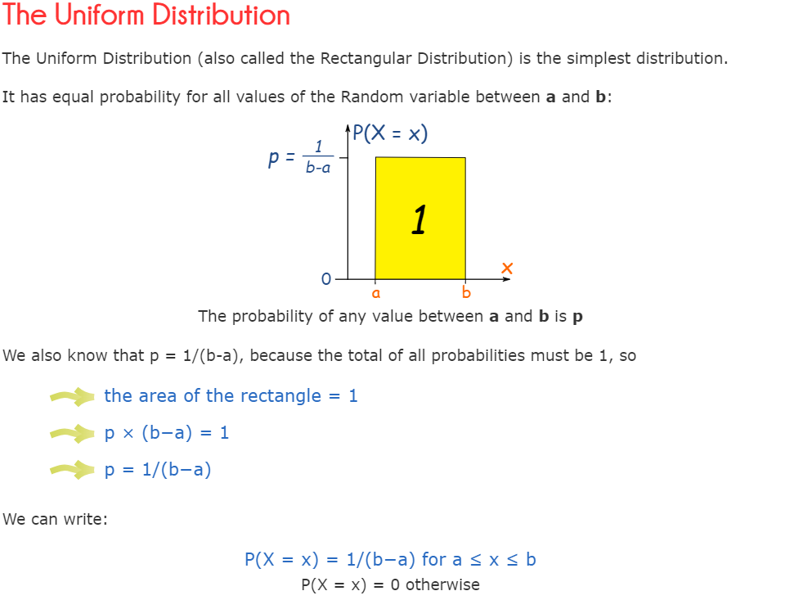

Slide 33
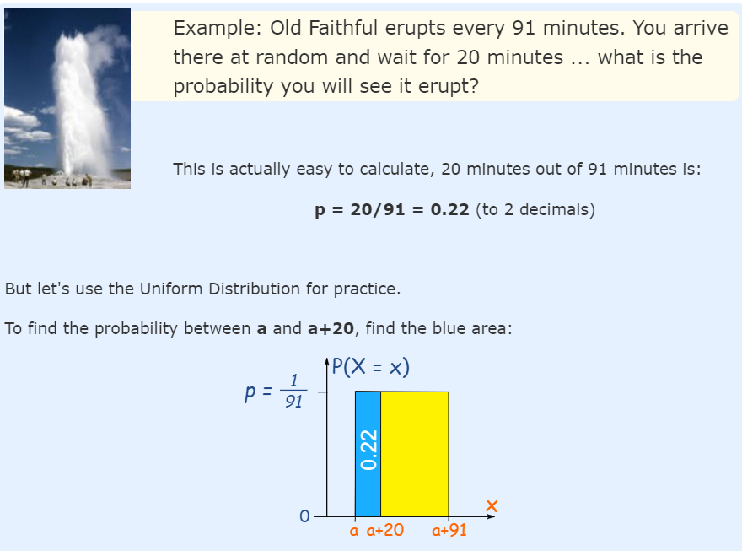

Slide 34
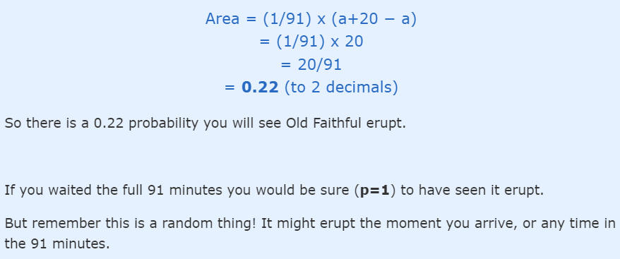

Slide 36
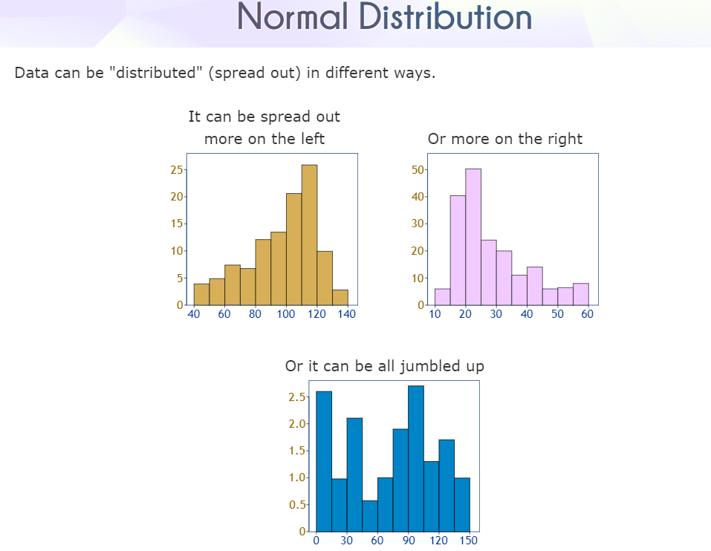

Slide 37
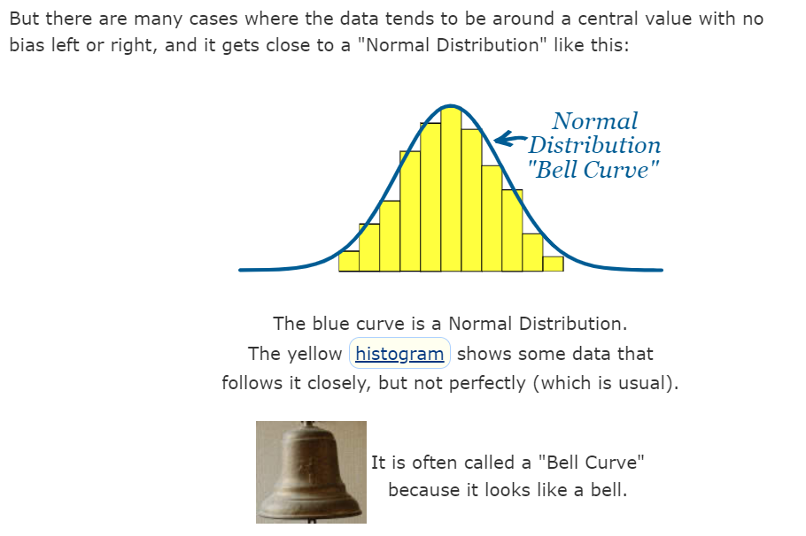

Slide 38
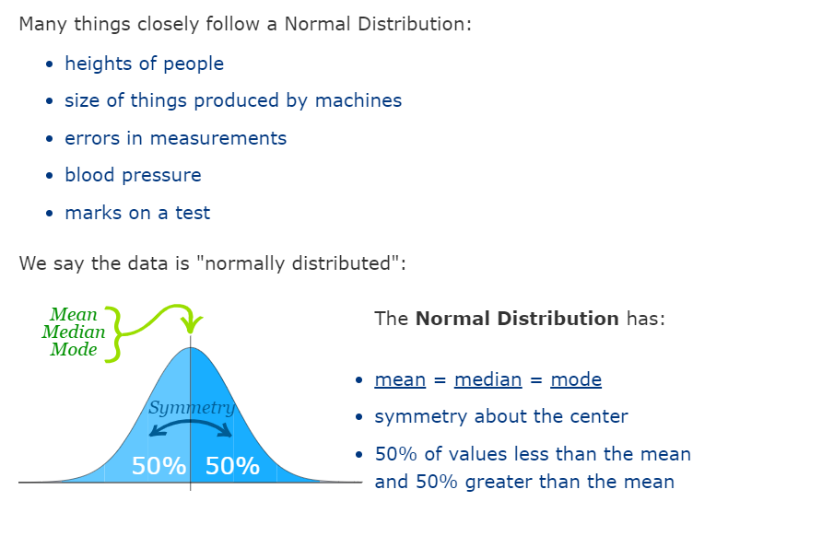

Slide 39
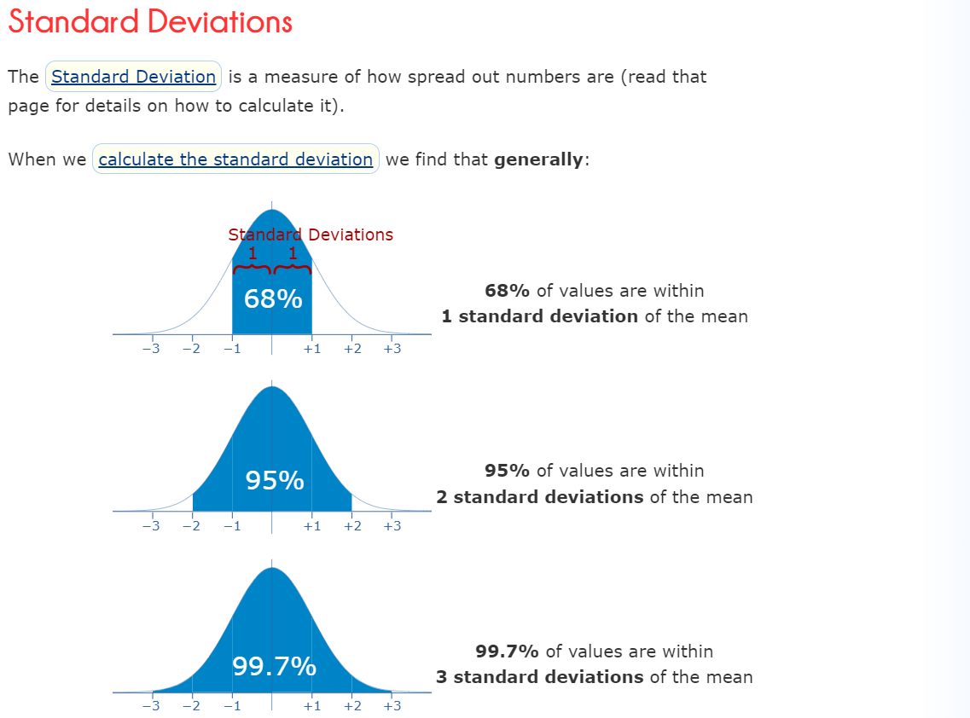

Slide 40
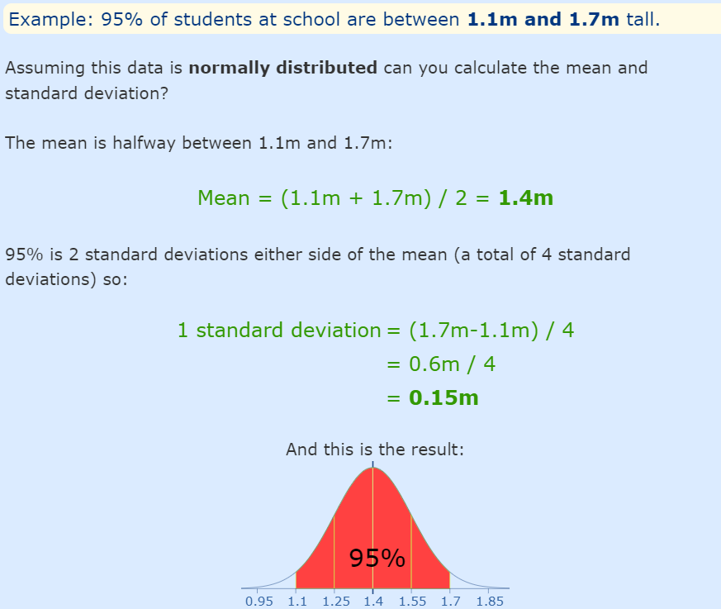

Slide 41
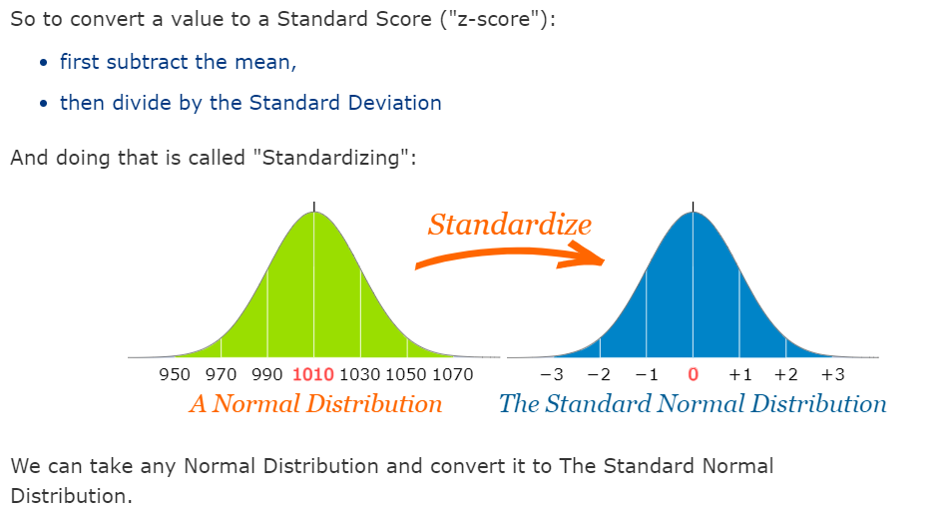

Slide 42
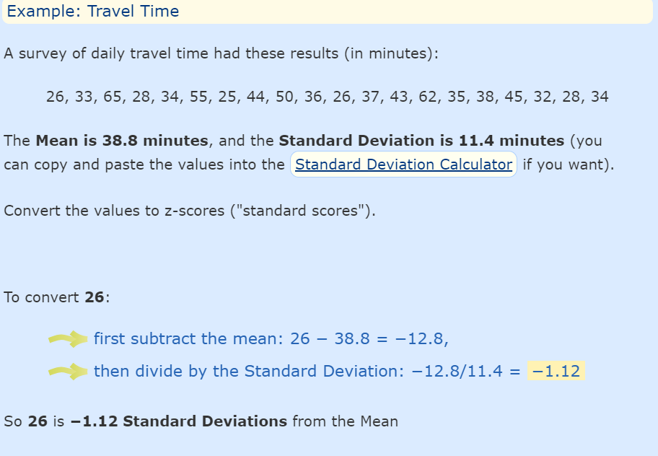

Slide 43
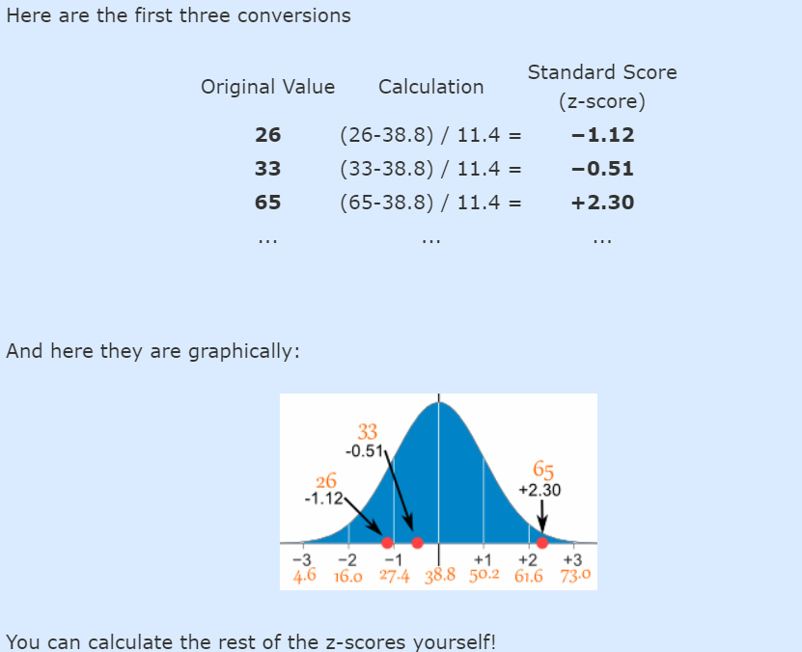

Slide 44
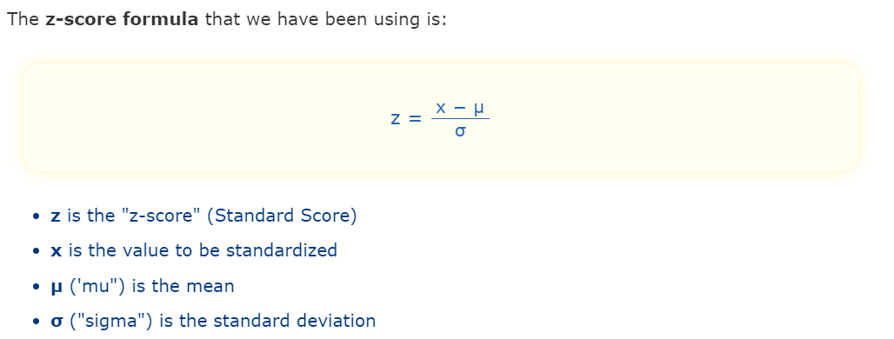

Slide 45
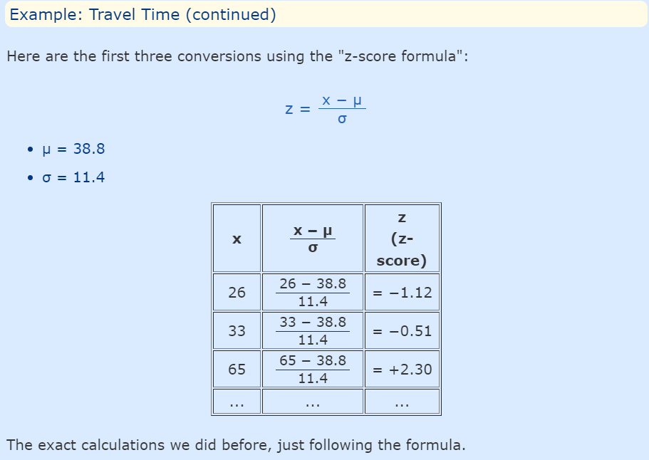

Slide 46
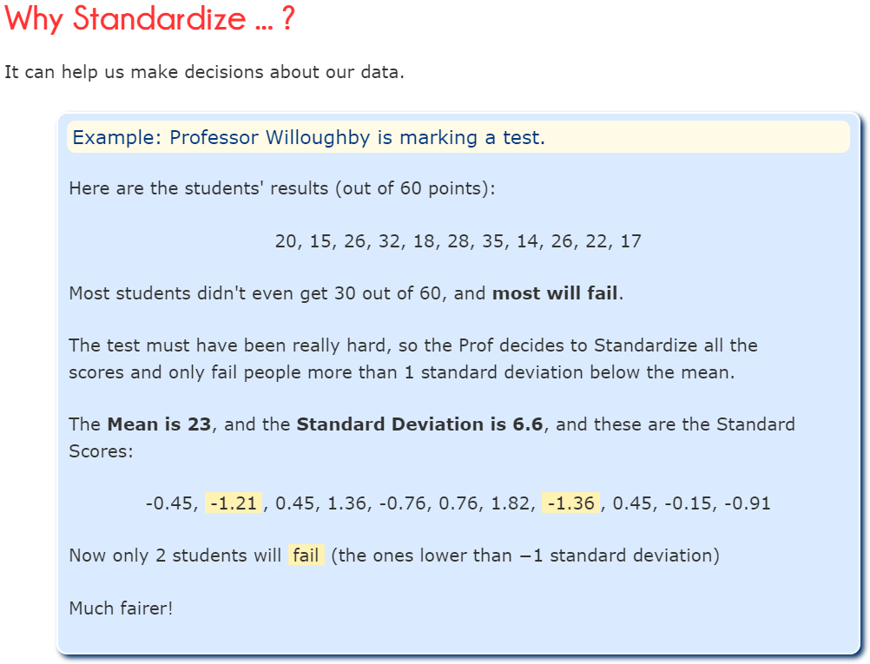

Slide 47
Central Limit Theorem
The Central Limit Theorem states that the sampling distribution of the sample means approaches a normal distribution as the sample size gets larger — no matter what the shape of the population distribution. This fact holds especially true for sample sizes over 30.
All this is saying is that as you take more samples, especially large ones, your graph of the sample means will look more like a normal distribution.
The picture shows one of the simplest types of test: rolling a fair die. The more times you roll the die, the more likely the shape of the distribution of the means tends to look like a normal distribution graph.

Slide 48
